Slide 1

GROUP-9
Airline Passenger Satisfaction
Christopher Louis - C14190088
Arnol Hadi Wijaya - C14190092
Daniel MArthin - C14190086 (Ketua)

Slide 2
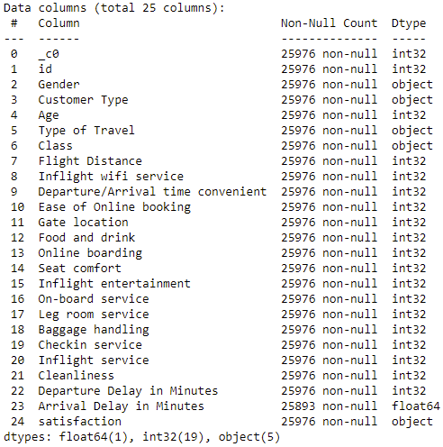
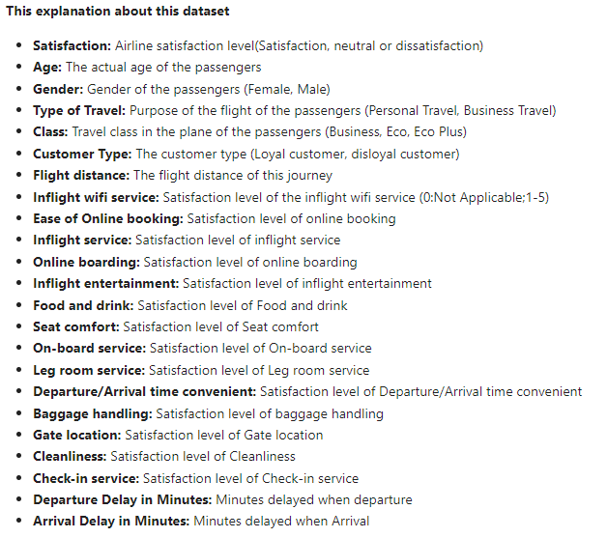
DATASET

Slide 3
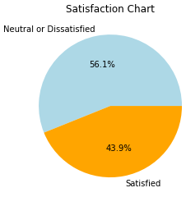

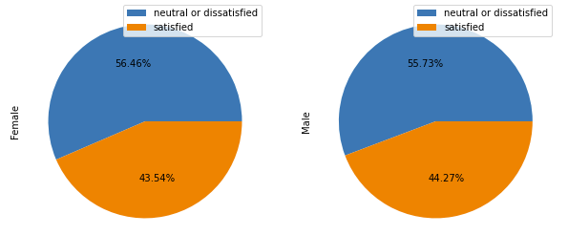
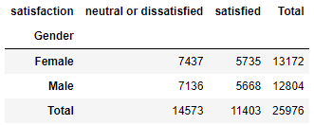
SATISFACTION
DANIEL
ARNOL
LOUIS
GENDER
Notes:
Gender menurut kami dilihat dari datanya tidak terlalu berpengaruh terhadap satisfaction

Slide 4
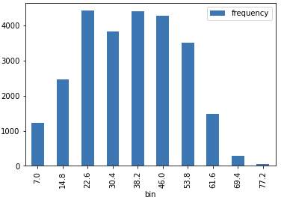
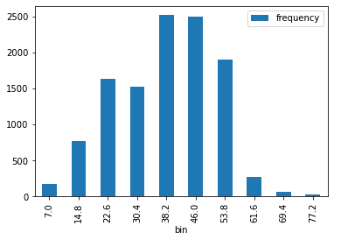
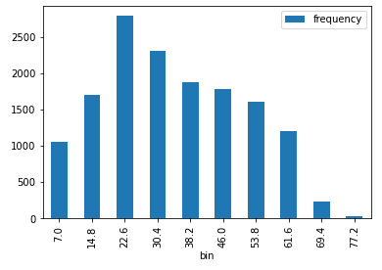
AGE ALL
AGE SATISFIED
AGE NEUTRAL
OR DISSATISFIED

Slide 5
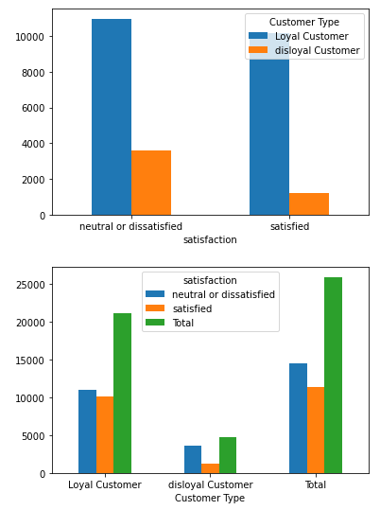
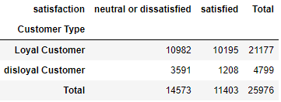
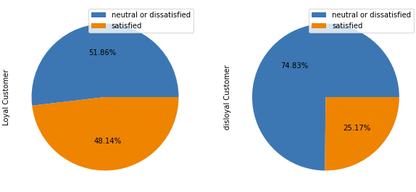
CUSTOMER TYPE

Slide 6
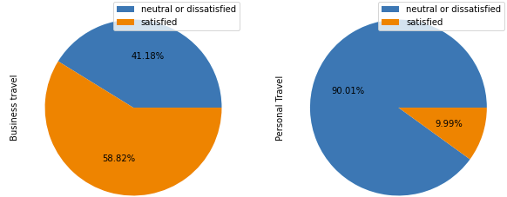
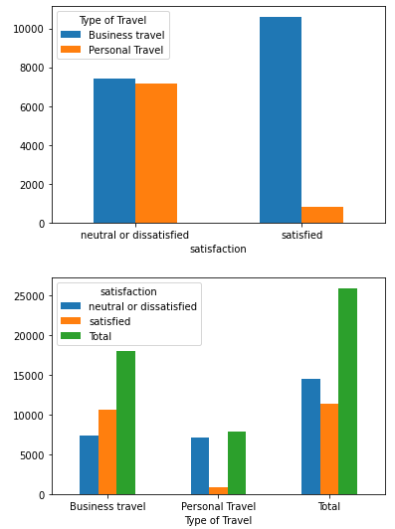
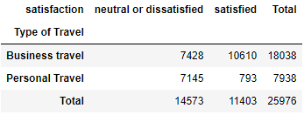
TYPE OF TRAVEL

Slide 7
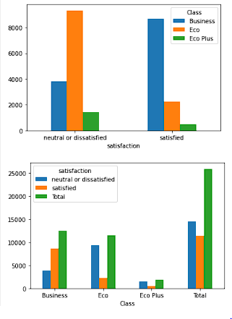
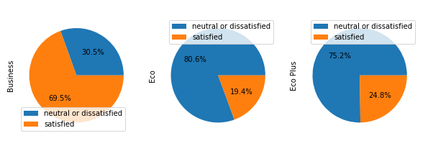
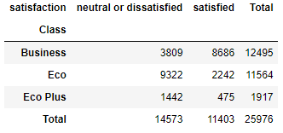
CLASS

Slide 8
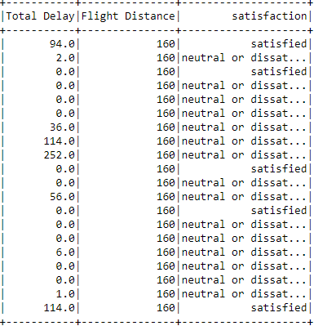
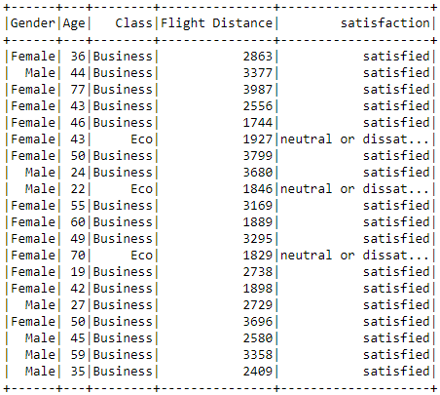
TOTAL DELAY
FLIGHT DISTANCE

Slide 9
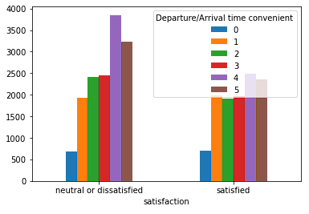

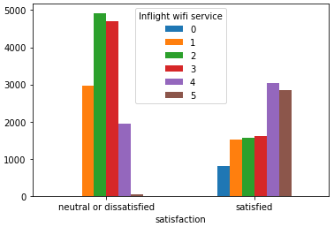

INFLIGHT WIFI SERVICE
DEPARTURE/ARRIVAL TIME CONVENIENT

Slide 10
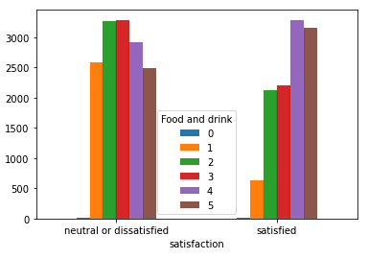

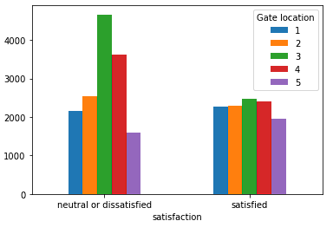

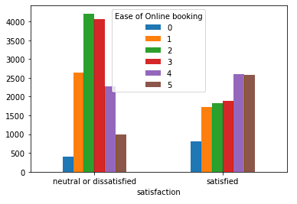

FOOD AND DRINK
GATE LOCATION
EASE OF ONLINE BOOKING

Slide 11
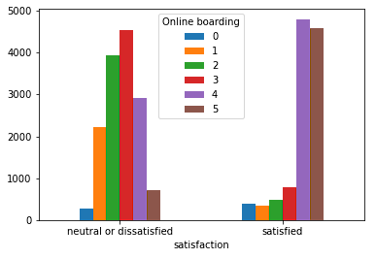

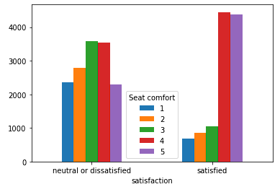

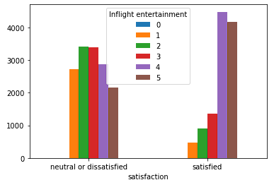

ONLINE BOARDING
SEAT COMFORT
INFLIGHT ENTERTAINTMENT

Slide 12
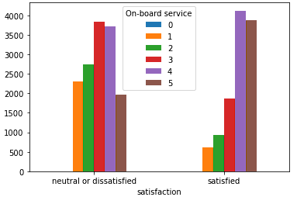

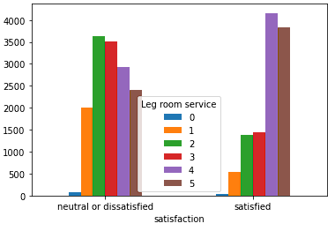

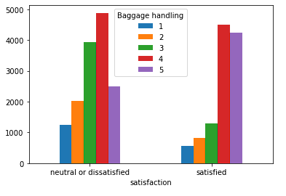

ON-BOARD SERVICE
LEG ROOM SERVICE
BAGGAGE HANDLING

Slide 13
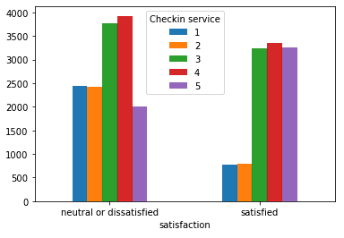

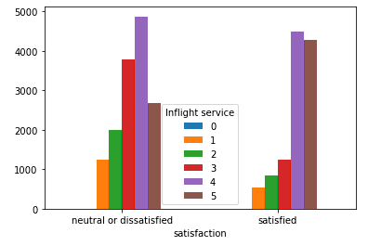

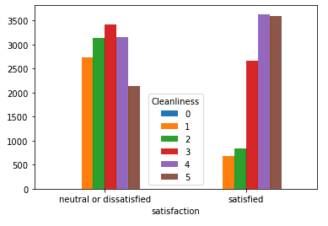

CHECKIN SERVICE
INFLIGHT SERVICE
CLEANLINESS

Slide 14
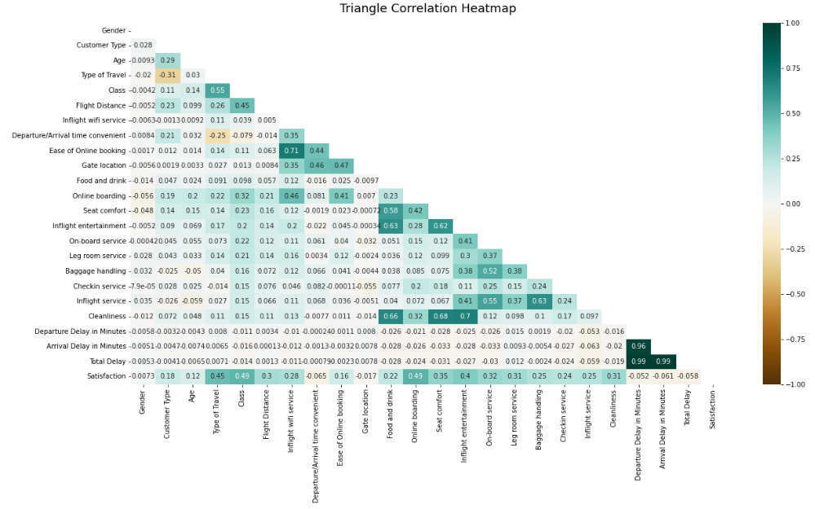
TOP 5 ATTRIBUTES WITH HIGHEST CORRELATION
Class
Online boarding
Type of Travel
Inflight entertainment
Seat comfort
CLOSE TO ZERO
Gender
Departure/Arrival time convenient
Gate Location
Departure Delay in Minutes
Arrival Delay in Minutes
Total Delay

Slide 15
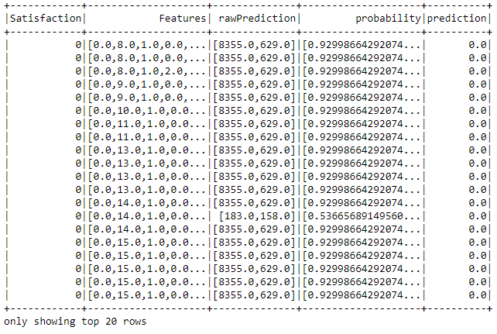



Decision Tree

Slide 16
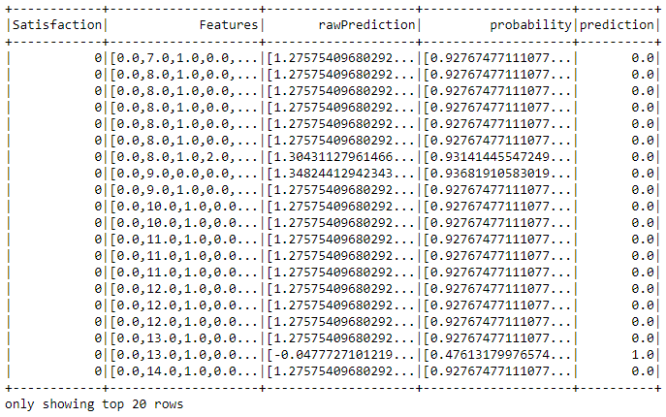


Gradient Boosted Tree

Slide 17
Feature Importances
0 = 'Customer Type',
1 = 'Age',
2 = 'Type of Travel'
3 = 'Class',
4 = 'Flight Distance'
,5 = 'Inflight wifi service',
'6 = Ease of Online booking',
7 = 'Food and drink',
8 = 'Online boarding',
9 = 'Seat comfort',
10 = 'Inflight entertainment',
11 = 'On-board service',
12 = 'Leg room service',
'13 = Baggage handling'
,14 = 'Checkin service'
,15 = 'Inflight service'
,16 = 'Cleanliness'
Decision Tree
Gradient Boosted Tree

Slide 18
CONCLUSION
INFLIGHT WIFI SERVICES
ONLINE BOARDING
Maskapai untuk fokus meningkatkan kenyamanan penumpang dalam melakukan online boarding (menyederhanakan UI/UX)
TUJUAN
Peningkatan pelayanan WIFI services dalam penerbangan (perkuat jaringan/ perluas jaringan)
Menciptakan model klasifikasi yang cukup akurat untuk membantu mencari faktor penghambat yang paling signifikan dan improve kepuasan penumpang
INFLIGHT ENTERTAINMENT
EASE OF ONLINE BOOKING
Peningkatan pelayanan entertainment bagi penumpang seperti film, musik, game, dll
Maskapai untuk fokus meningkatkan kenyamanan penumpang dalam melakukan online booking

Slide 19


